Slide 1
Detecting the Influencers in your Circle with Python
Hacktiv8 Indonesia
We’ll be starting shortly at 6.30pm (GMT+8)!
Submit all questions using the Q&A function
If you have an urgent request, please use the “Raise Hand” function

Slide 2
Who am I
Hello! My name is Fahmi.
Data Science Curriculum Developer and Instructor at Hacktiv8 Indonesia.
Experienced in professional data science and data analytics at startup companies.
Teaching hundreds of students and make tens of data science and analytics learning materials.

Slide 3
Hacktiv8 Indonesia
Hacktiv8 Prepares Professionals for high-growth careers in the Digital Economy.
We create skills-based training programs which is designed to meet the needs of employers.
By combining technical skills and the growth mindset, we deliver a holistic learning experience for professionals to succeed in their careers.

Slide 4

Student Experience and Career Success

Slide 5
More Info
www.hacktiv8.com
halo@hacktiv8.com
Facebook: Hacktiv8 Indonesia
Instagram & Twitter: Hacktiv8id
+62 21 5099 6662

Slide 6

Get to know us more!

Slide 7
Agenda
01
Social Network Analysis
02
Intro to Network
03
NetworkX
04
SNA in Action

Slide 8
Social Network Analysis - Why does it matter?

Slide 9
Social Network Analysis
01
What is SNA?
02
Identifying the influencers
03
The Impact

Slide 10
01 What is SNA?
Social Network Analysis (SNA) is a branch of network science that studying the interaction among humans.
We are social creatures and making complex interactions and community.
In SNA, we focus on how things work together, connectivity, and social systemic.

Slide 11
02 Identifying Influencer
SNA is about community and interactions. Whatever the community is, there are influencers.
To identify who are the influencers, we need to measure the centrality of each person in the community. We’ll talk about it later.
Centrality means that, how often they interact with others in two directions.

Slide 12
03 The Impact
Influencer is an agent of change
They can lead the community behaviour
In marketing, influencer is one of the most powerful marketing channel
In a complex organization, such as company, they can be a good leader

Slide 13
Intro to Network

Slide 14
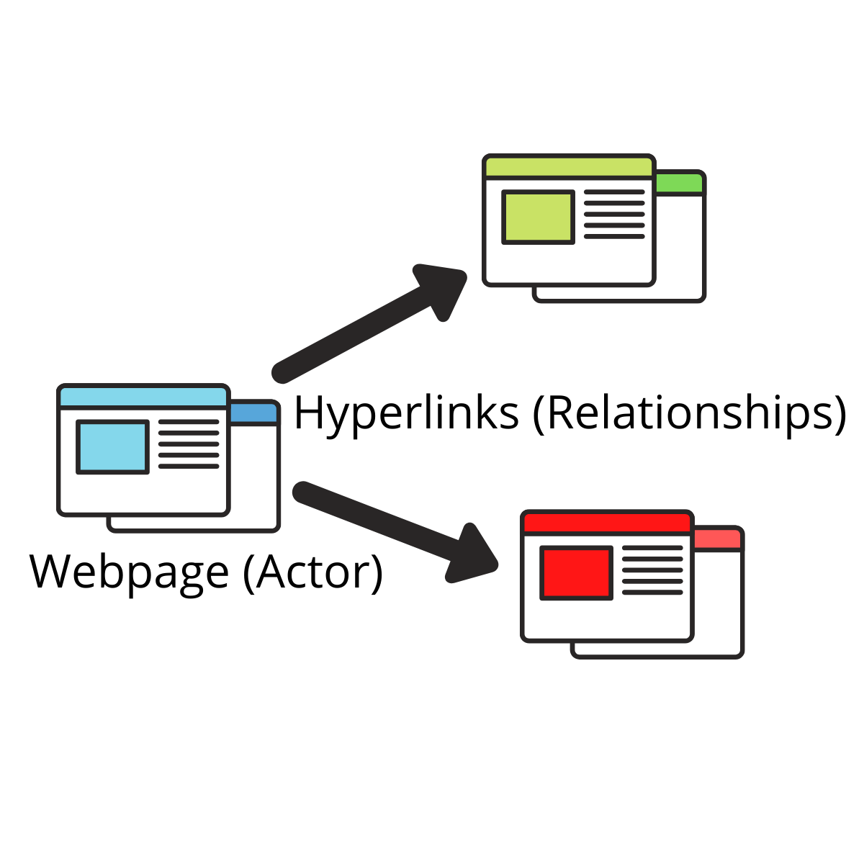
Components
In the social structure, there are two main components that are Actor and Relationships.
In network/graph theory, the actor is called Node and the relationship is called Edge.

Slide 15
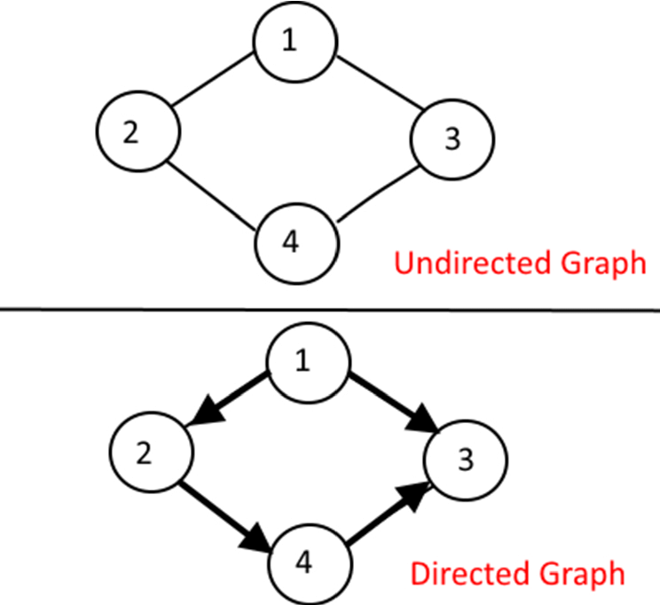
Relation
Undirected Graph means there is no clear relation direction.
For example: Anne and Lucy are friends on Facebook.
Directed Graph has clear from-and-to relation.
For example: Luke follows Mike on Twitter but Mike doesn’t follow Luke.

Slide 16
Edge Weight
An Edge’s weight is the number of times that edge appears between two specific nodes.
For example, if Person A buys a coffee from a coffee shop 3 times, the edge connecting Person A and the coffee shop will have a weight of 3.

Slide 17
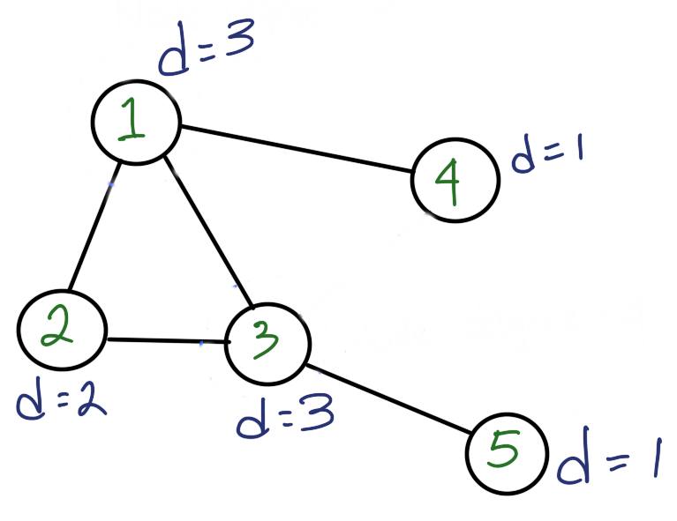
Centrality - Node Degree
Node degree is equal to number of node’s neighbors.
The more neighbors means that a node is highly connected with others and have influence.
Based on the image beside, node-1 and node-3 are influencer.
Which one is the most influential node? We can’t get the answer yet.

Slide 18
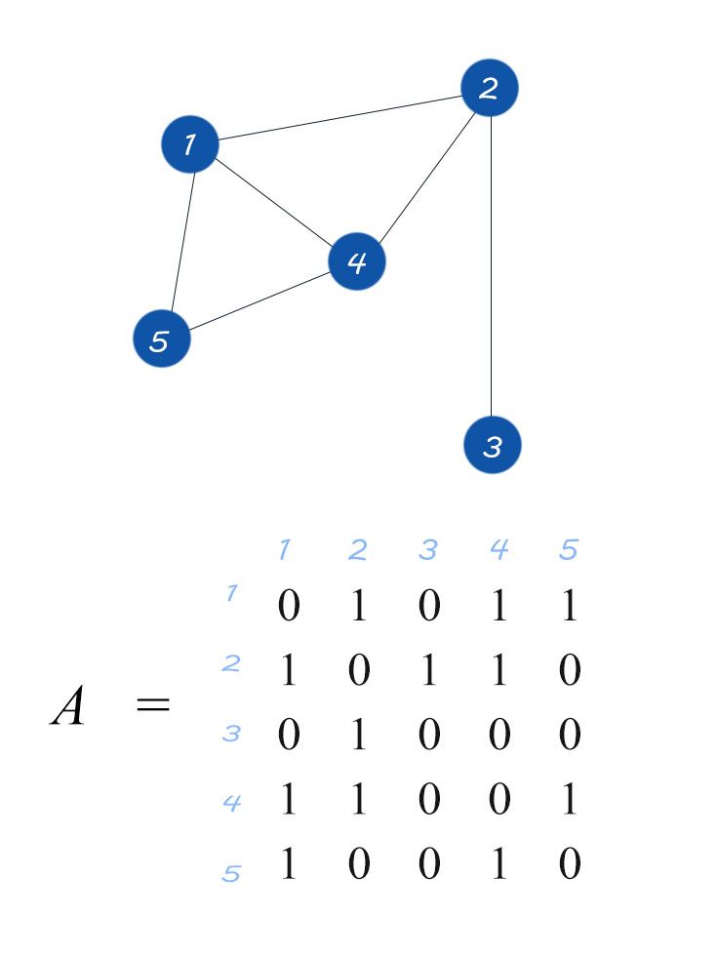
Centrality - Eigen Centrality
Eigenvector Centrality will take account of the neighbors’ connection number. It also measures the importance of nodes.
Using eigenvector concept (take a look the Linear Algebra, please!), the eigen centrality is the eigenvector element of adjacent matrix with the biggest eigenvalue.
However, this centrality has bias. For example, if you follow Elon Musk, doesn’t mean you important!. Otherwise, if he follows you, maybe you’re an important person.

Slide 19
Centrality - PageRank
PageRank is invented by Lary Page (One of the Google founder) on his thesis.
In order to reduce the bias, PageRank can flatten the effect of the bias that occur on Eigen Centrality using damping factor on the calculation.
Important nodes are those with many inlinks from important pages.

Slide 20
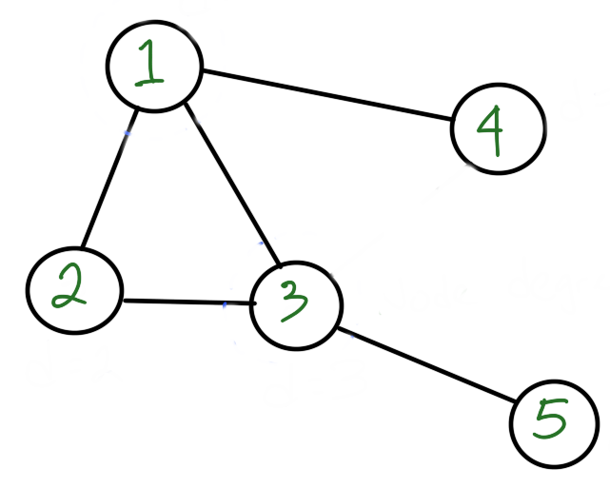
Centrality - Closeness
Closeness Centrality measures the average of the path length a node to others. The higher closeness means more efficient to spread the information to other nodes or closer to others.
For example, to share information from node-2 to node-5, it would take two edge. Otherwise, node-3 to node-5 only take an edge.

Slide 21
Centrality - Betweenness
Betweenness Centrality determines how influence a node to control over flow between nodes and groups.
Node-1 and Node-3 may have a high closeness, but Node-3 that has the highest betweenness.

Slide 22
NetworkX

Slide 23

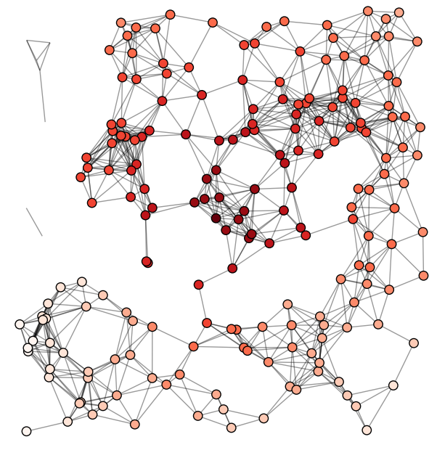
NetworkX is a Python package for the creation, manipulation, and study of the structure, dynamics, and functions of complex networks.
https://networkx.org/documentation/stable/tutorial.html

Slide 24
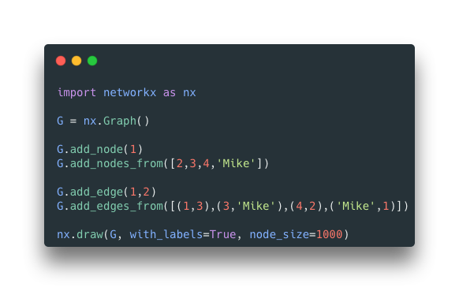
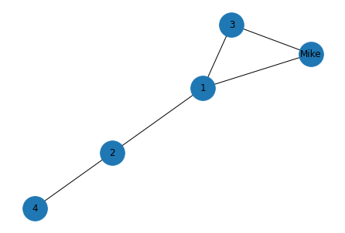
Make a Graph! - Undirected

Slide 25
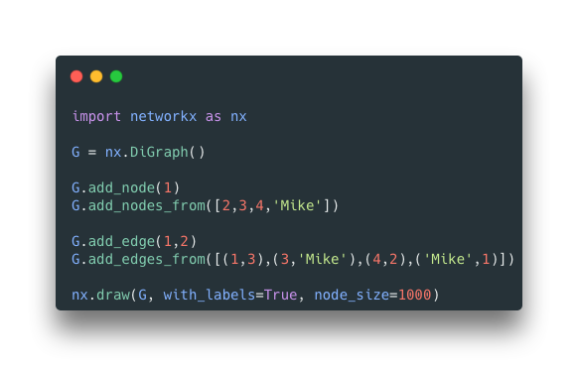
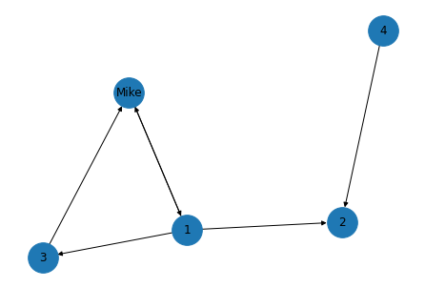
Make a Graph! - Directed

Slide 26
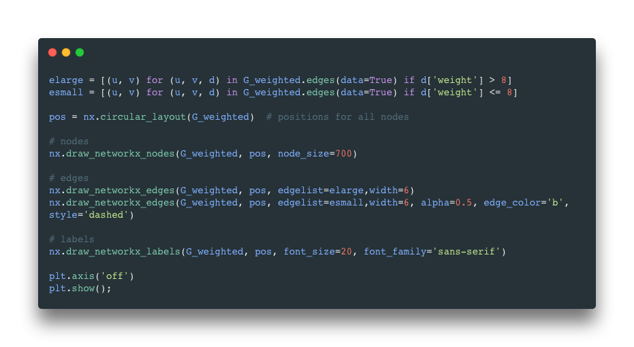
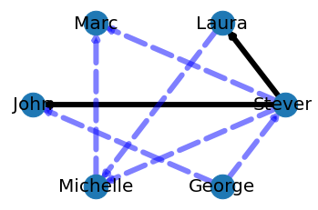
Make a Graph! - Weighted
G_weighted.add_edge('Steven', 'Laura', weight=25)

Slide 27
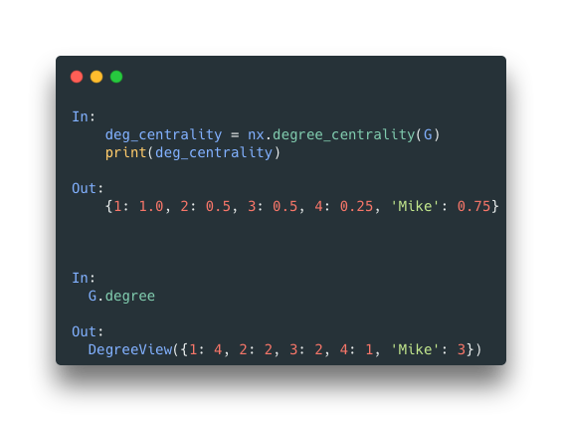
Measure Centrality - Node Degree
Node - 1 has the most neighbors

Slide 28
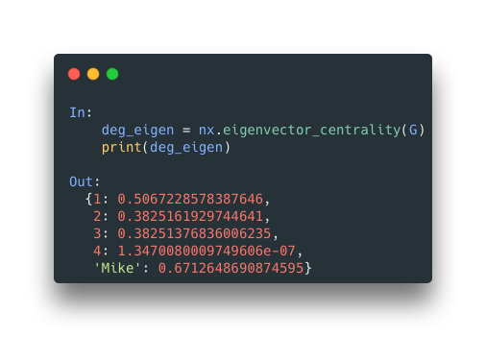
Measure Centrality - Eigenvector
Mike is the most important node, despite it doesn’t have many neighbors than 1

Slide 29
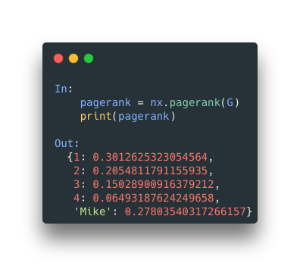
Measure Centrality - PageRank
According to the eigenvector, Mike is the most important but if we take account who are the neighbors, Node - 1 is an influencer in this network.

Slide 30
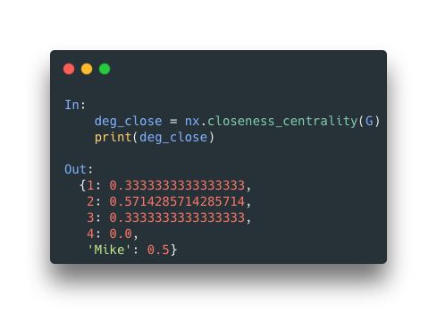
Measure Centrality - Closeness
Node - 2 is the most efficient node in terms of communication path

Slide 31
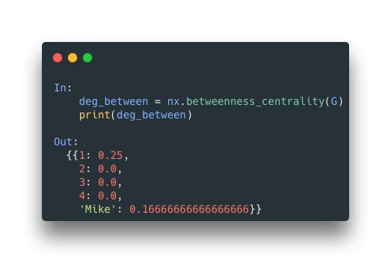
Measure Centrality - Betweenness
Despite Node - 2 is the closest one to others, but Node - 1 could reach others easily.

Slide 32
SNA in Action

Slide 33
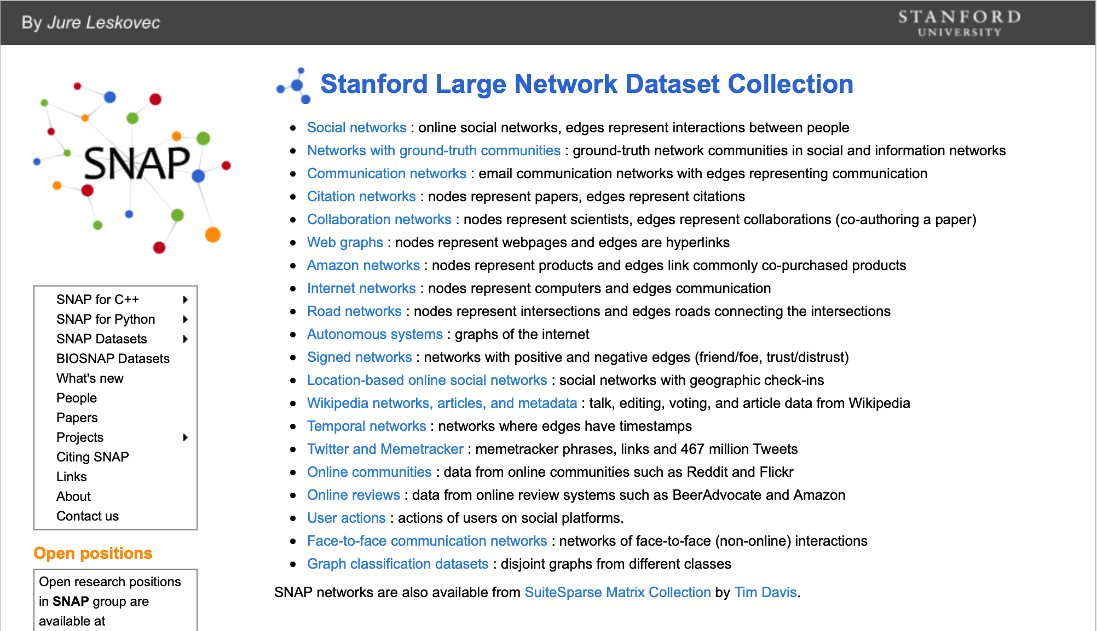
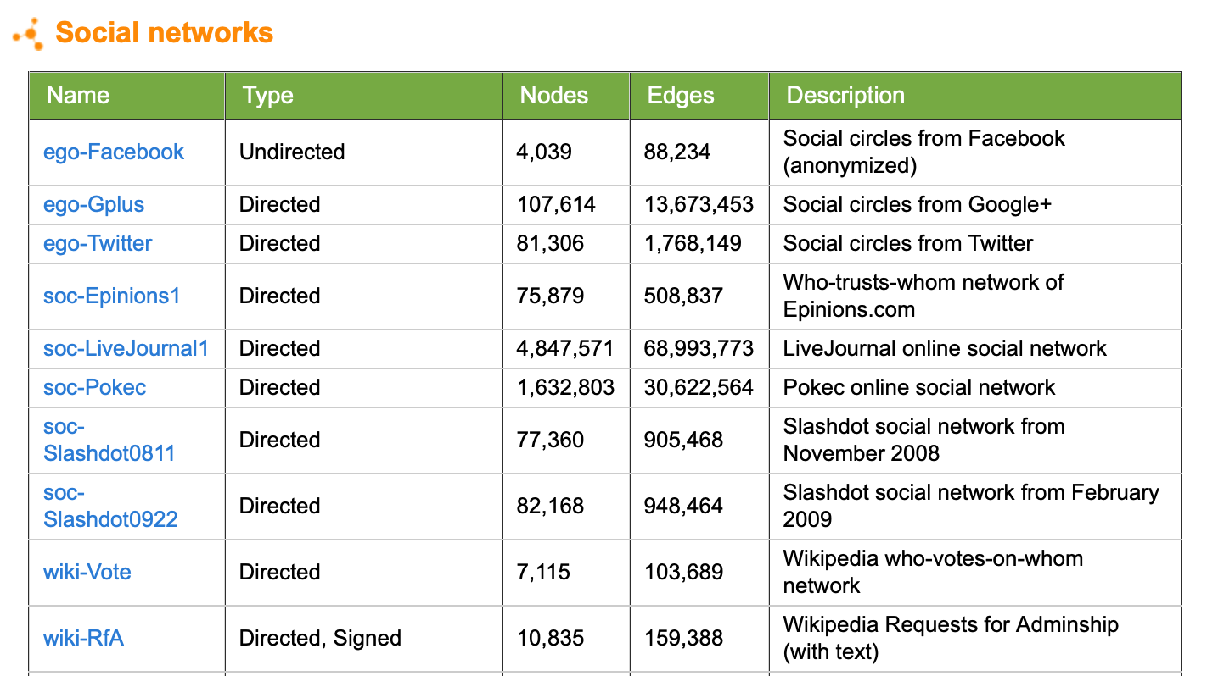
Dataset
The data provided by Stanford Large Network Dataset.

Slide 34
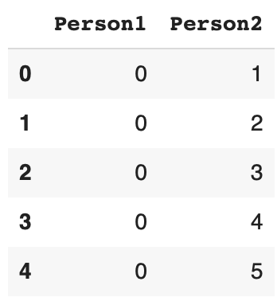
Dataset
Consist of 88234 rows and two columns.
The graph consists of 4039 nodes and 88234 edge

Slide 35
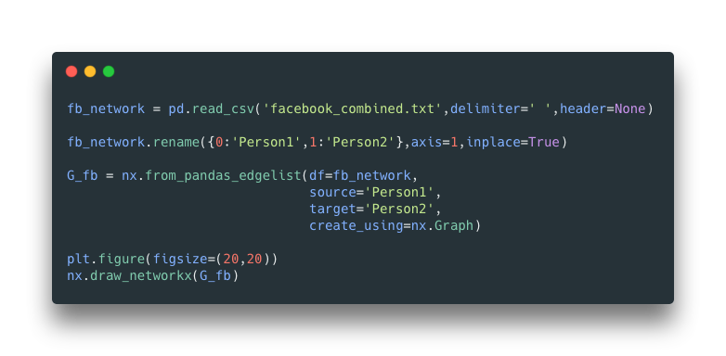
Draw Graph

Slide 36
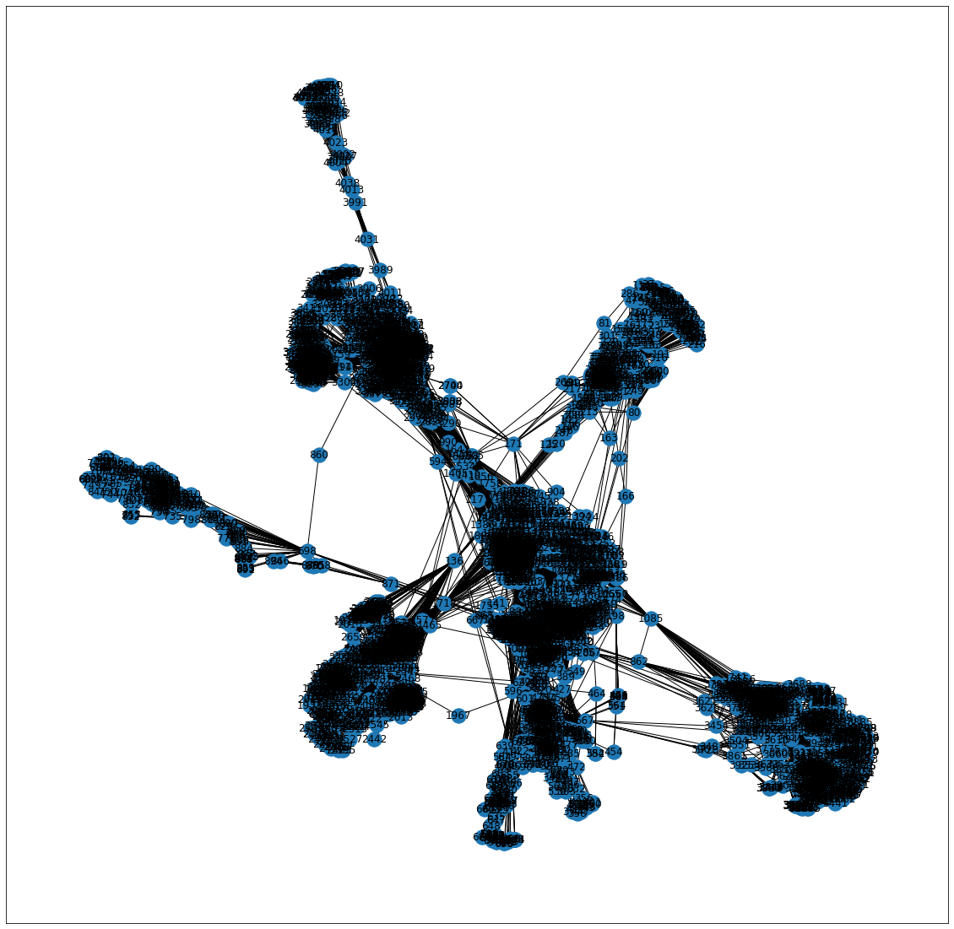

Slide 37
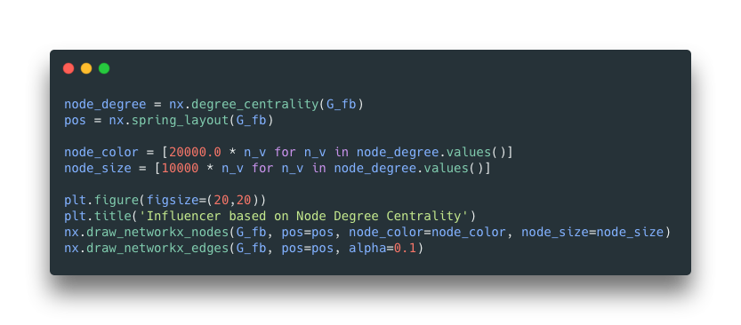
Centrality

Slide 38
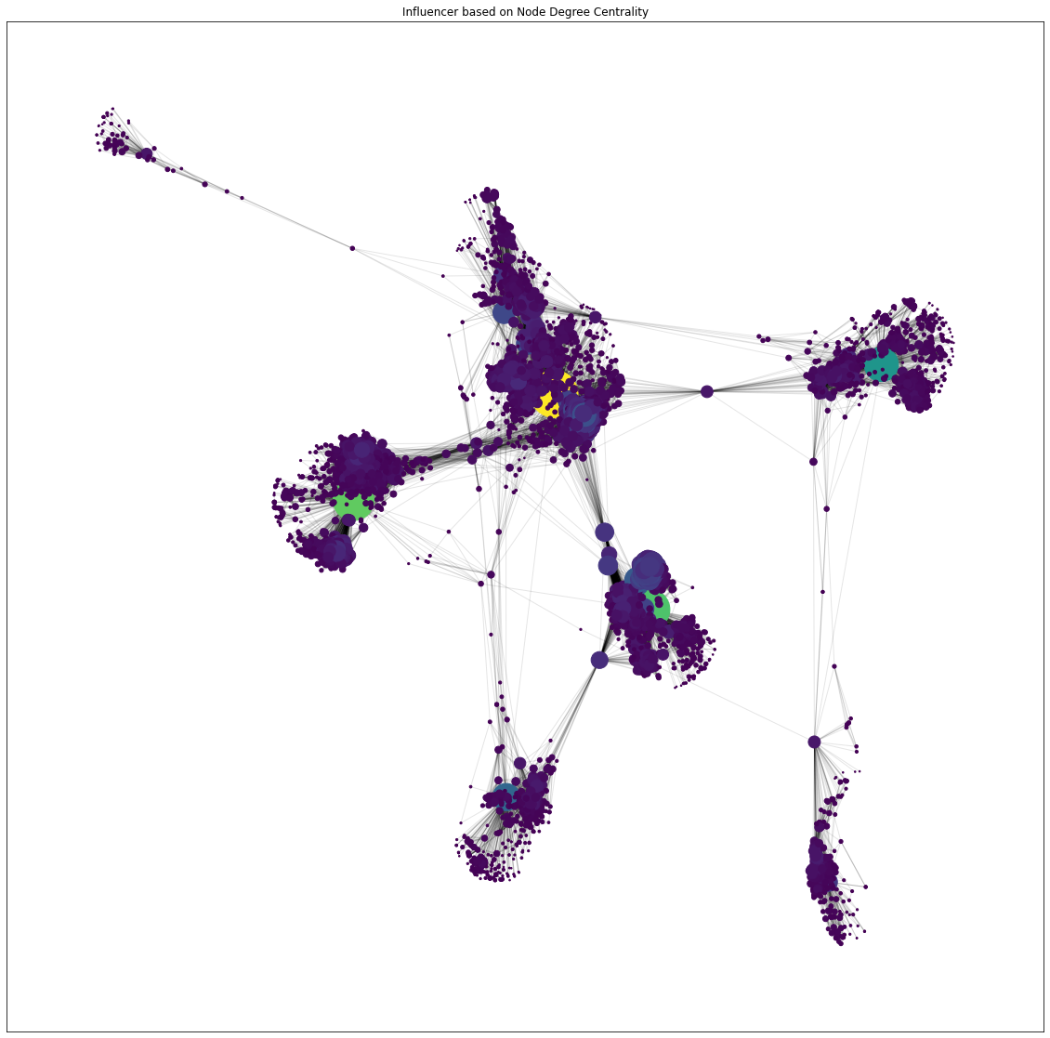
Node Degree
The bigger nodes posses higher node degree which means they have many connections.
Top 10
107 = 1045
1684 = 792
1912 = 755
3437 = 547
0 = 347
2543 = 294
2347 = 291
1888 = 254
1800 = 245
1663 = 235

Slide 39
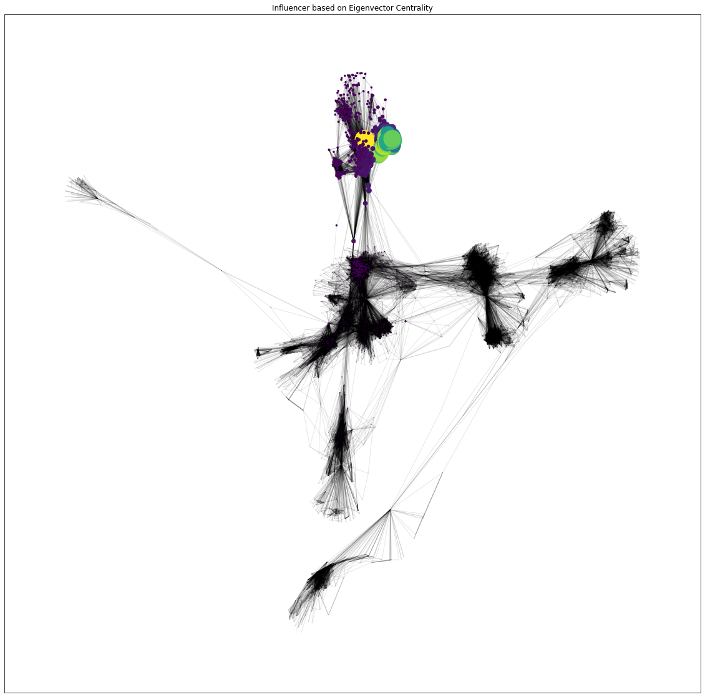
Eigenvector
Eigenvector tells how important the nodes based on who are their neighbors.
Top 10
1912 = 0.10
2266 = 0.09
2206 = 0.09
2233 = 0.09
2464 = 0.08
2142 = 0.08
2218 = 0.08
2078 = 0.08
2123 = 0.08
1993 = 0.08

Slide 40
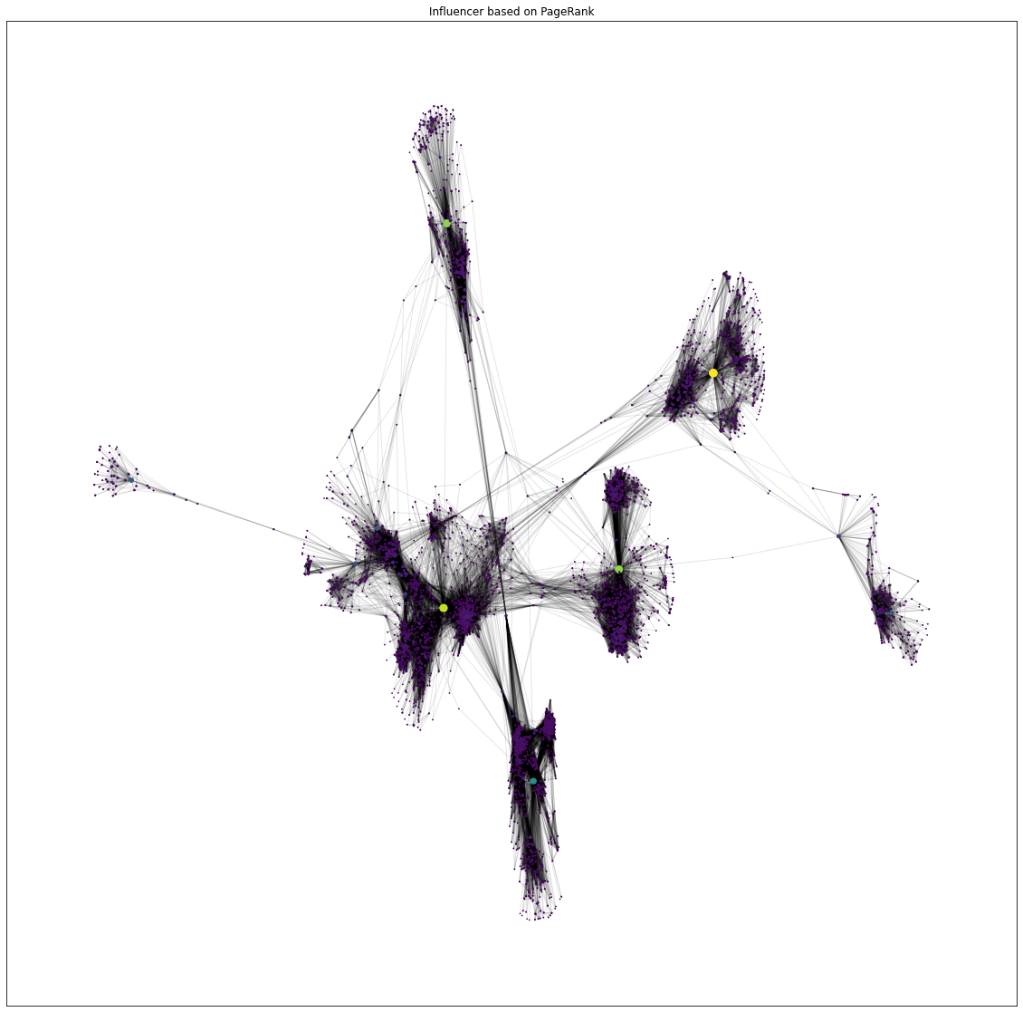
PageRank
All nodes don’t have bigger PageRank. Only 4 nodes that have non-null PR.
Non-Null
3437 = 0.01
107 = 0.01
1684 = 0.01
0 = 0.01
All nodes that have PageRank are top 10 the most connection.

Slide 41
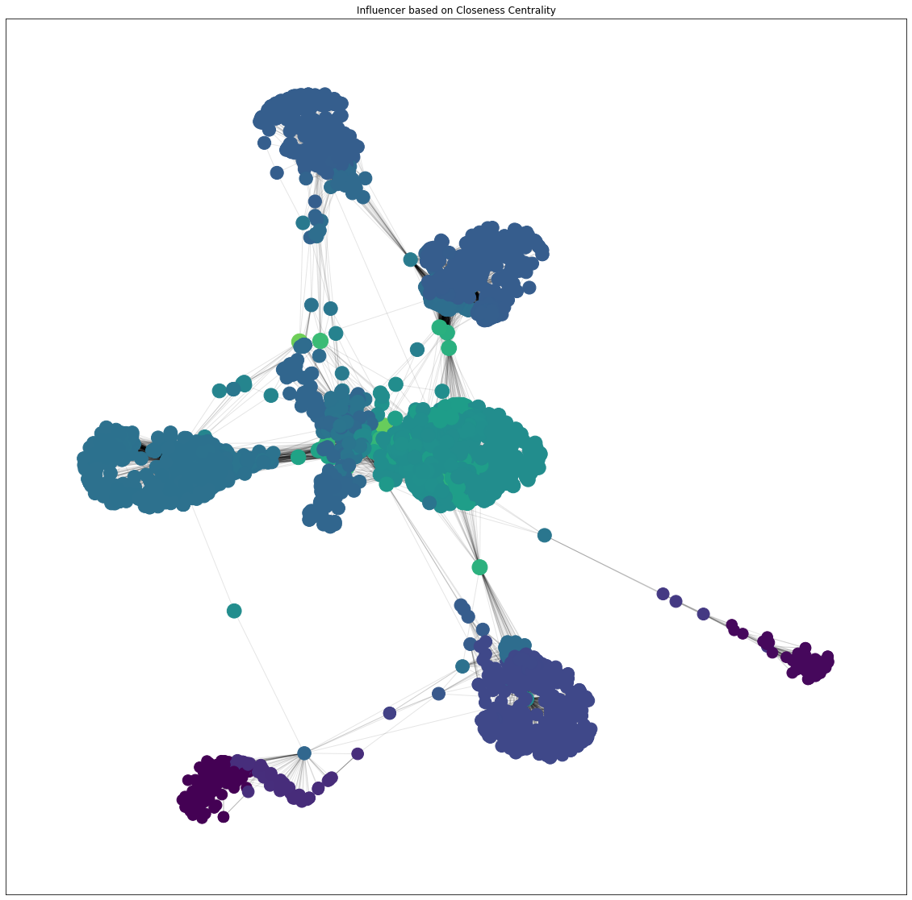
Closeness
Many nodes have ability to spread information efficiently since they close each other.
Top 10
107 = 0.46
58 = 0.40
428 = 0.39
563 = 0.39
1684 = 0.39
171 = 0.37
348 = 0.37
483 = 0.37
414 = 0.37
376 = 0.37

Slide 42
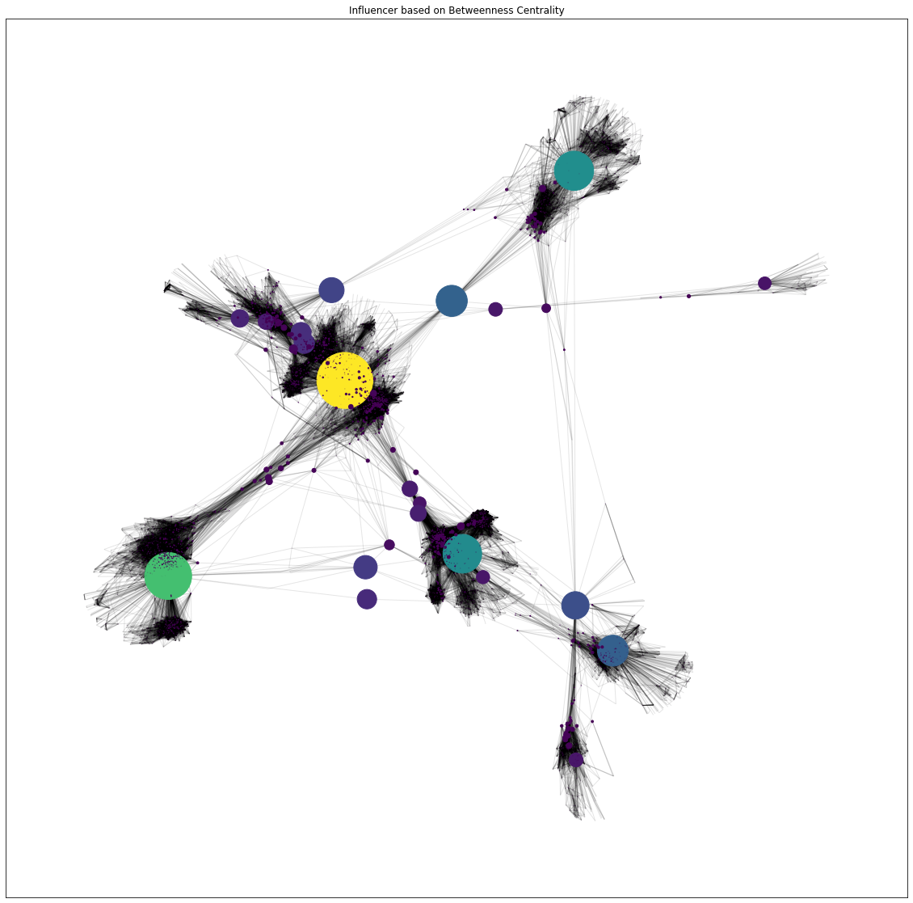
Betweenness
The bigger size of nodes, the mode ability to reach other sub-communities.
Top 10
107 = 0.48
1684 = 0.34
3437 = 0.24
1912 = 0.23
1085 = 0.15
0 = 0.15
698 = 0.12
567 = 0.10
58 = 0.08
428 = 0.06

Slide 43
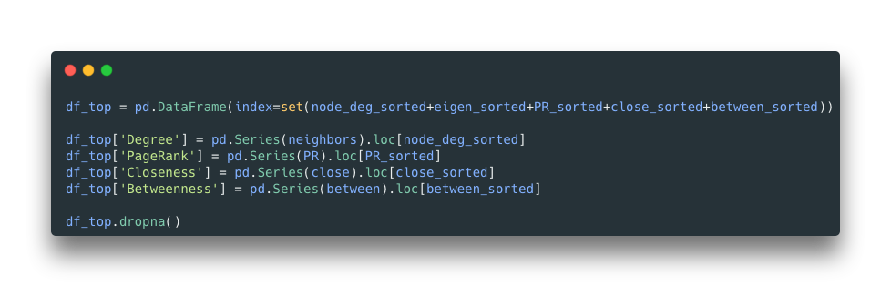
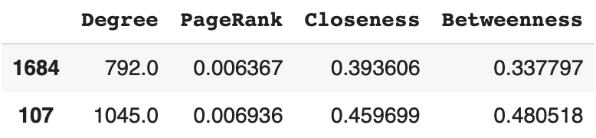
Who is the influencer?

Slide 44
Resource
You can access the materials here:
https://github.com/fahmimnalfrzki/H8_SCL_2022_SNA

Slide 45
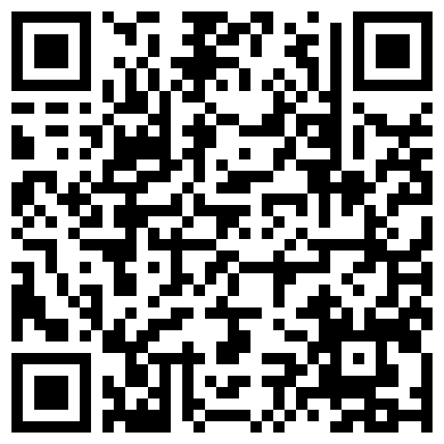
Your Feedback Matters!

Slide 46
Get to know us more!

